Slide 1
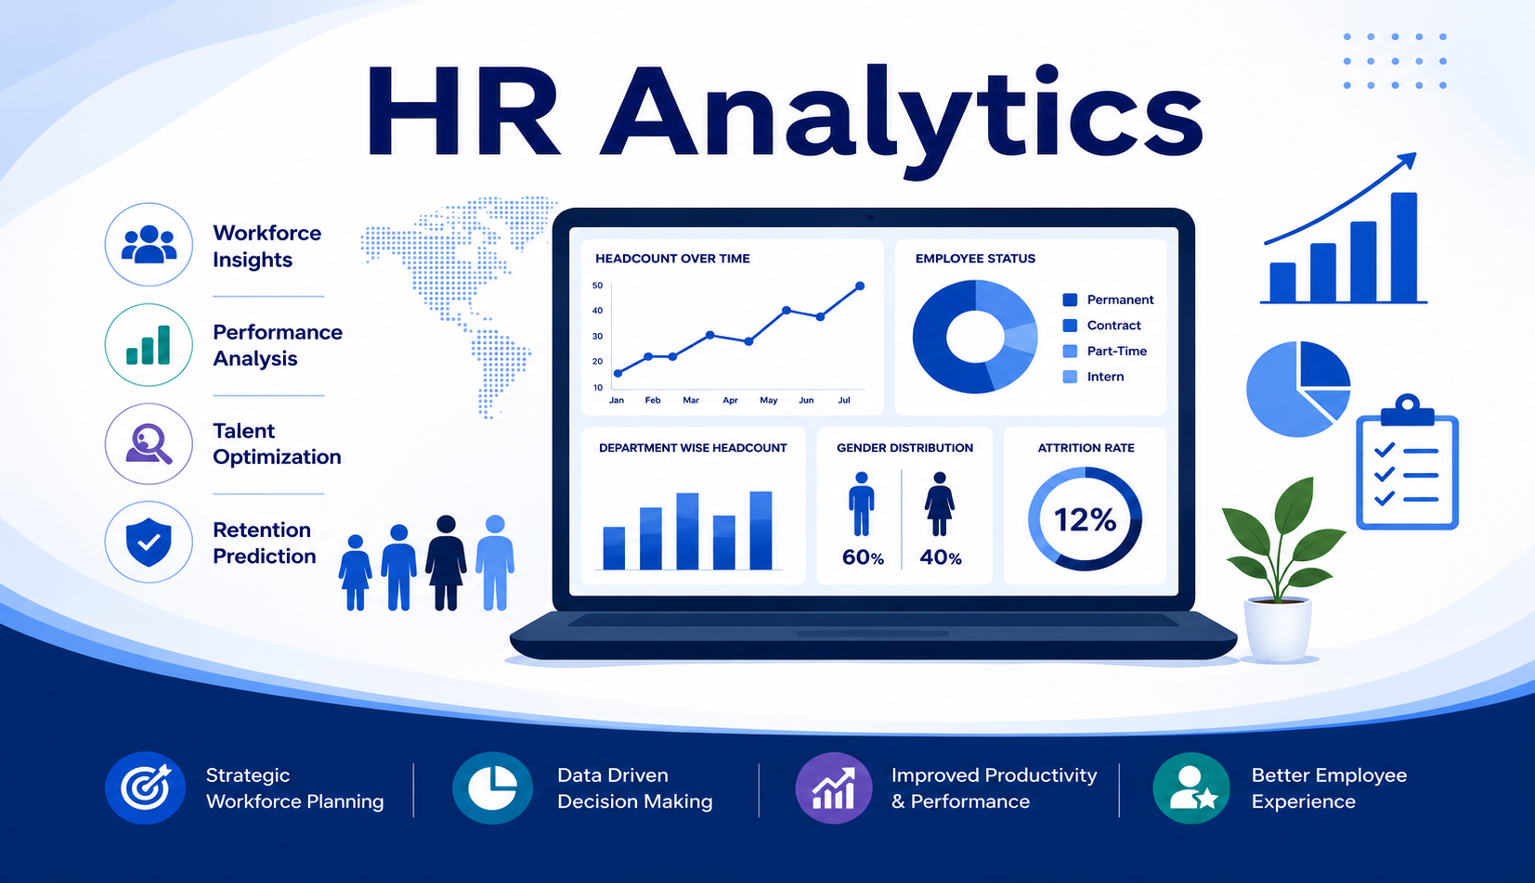

Slide 2
Contents :-
1. Project Overview & Objective
2. Data Cleaning and Modeling
3. KPI LIST
4. Dashboard Presentation
5. Challenges Faced
6. Solutions Implemented
7. Conclusion

Slide 3
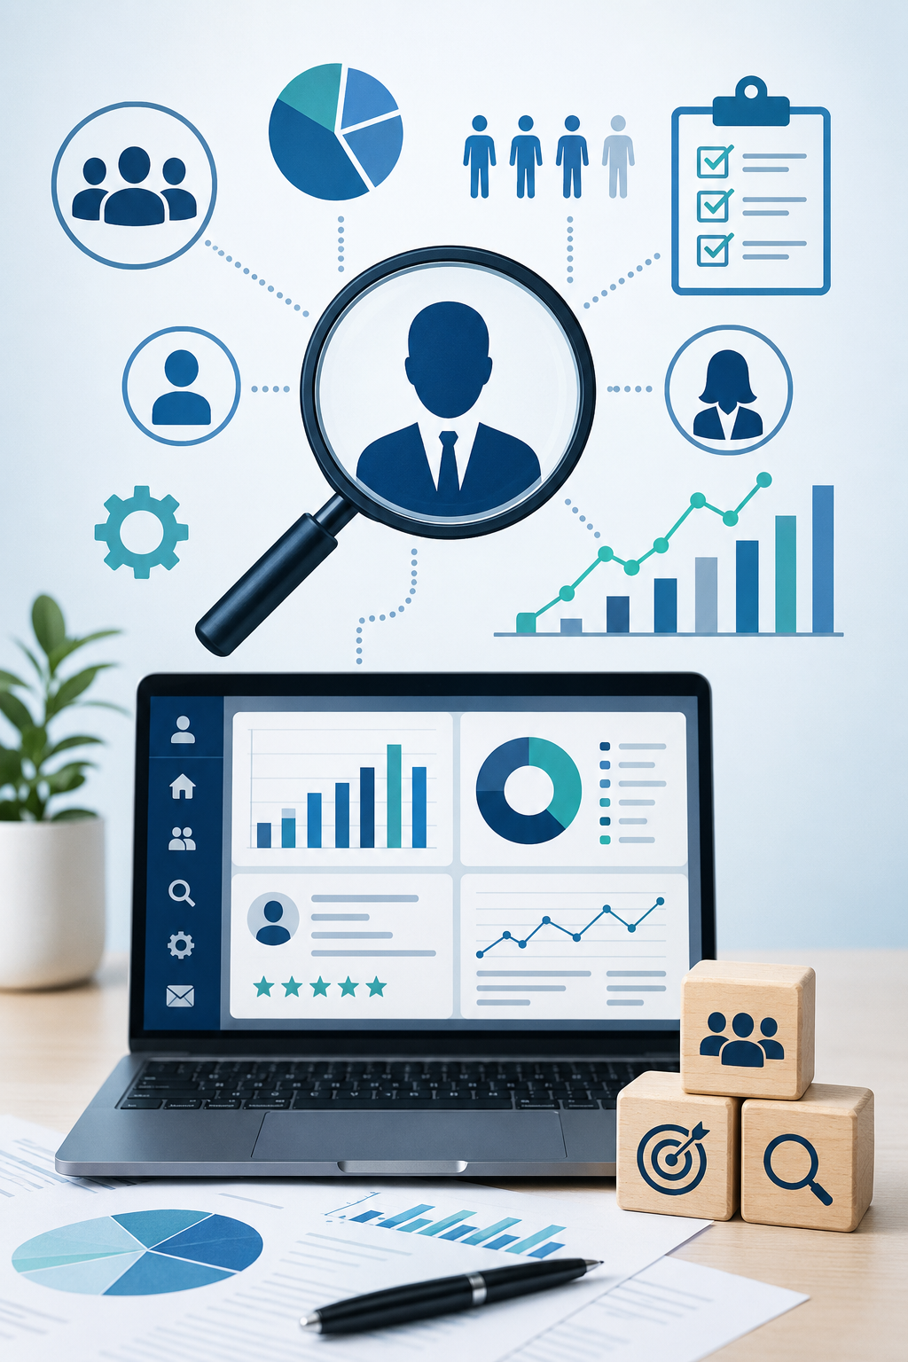
Project Overview & Objective
Project Overview
This project is based on HR Analytics using two datasets: HR_1 and HR_2.
Both datasets were connected using the common column Employee_Number.
The main objective of the project is to analyze employee attrition and workforce performance.
The dashboard helps understand employee behavior, salary trends, promotion impact, and work-life balance.
KPIs were created to track important HR metrics such as Attrition Rate, Average Income, Employee Age, and Working Years.
Different charts and heatmaps were used to make insights easy to understand.
The project helps HR teams make better decisions for employee retention and workforce planning.
Team & Timeline
.
4-week project duration, evolving through various tools:
Week 1: Excel for initial data exploration.
Week 2: Tableau for initial modeling and visualization.
Week 3: Powerbi and SQL for advanced analysis.
Week 4: Final presentation preparation.
Key Goal: Ensure consistent Key Performance Indicators (KPIs) across all analytical tools used.

Slide 4





Data Cleaning And Data Modeling
Distributed Cleaning
Rigorous Cleaning
I am responsible for cleaning and modeling one specific dataset, ensuring thorough initial processing.
Systematic removal of duplicates and comprehensive handling of missing values across all datasets to maintain data integrity.
Seamless Integration
Standardized KPIs
All individual sheets were meticulously merged into a single, cohesive master dataset, ready for unified analysis.
Implemented a unified set of KPIs, ensuring consistency and comparability across Power BI, Tableau, and SQL environments.
This structured approach to data preparation was crucial for building a reliable foundation for our subsequent analysis and dashboard development.

Slide 5
KPI List
Total Employees = 50,000
Attrition Rate = 50.21%
Average Employee Age = 38.97
Average Hourly Rate = ₹115.16
Average Monthly Income = ₹26,016
Average Working Years = 20.5
Average Tenure (Years) = 10.77

Slide 6
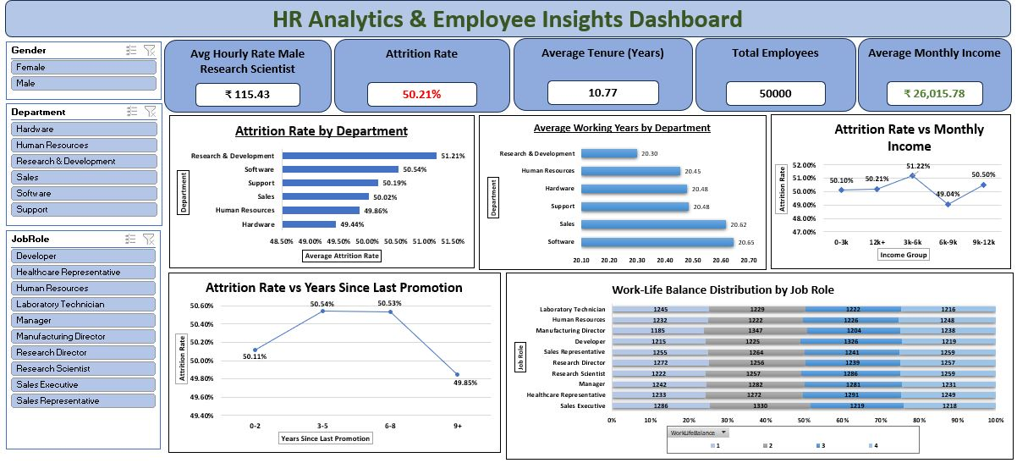
Excel Dashboard

Slide 7
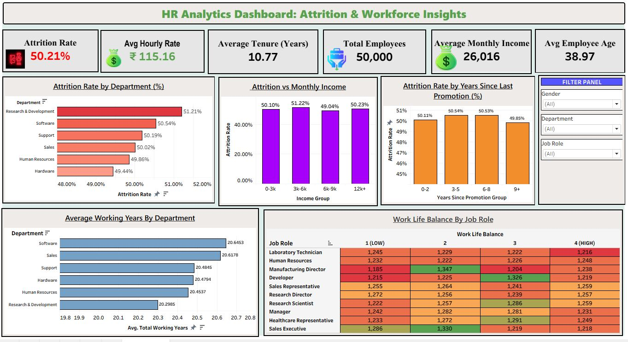
Tableau Dashboard

Slide 8
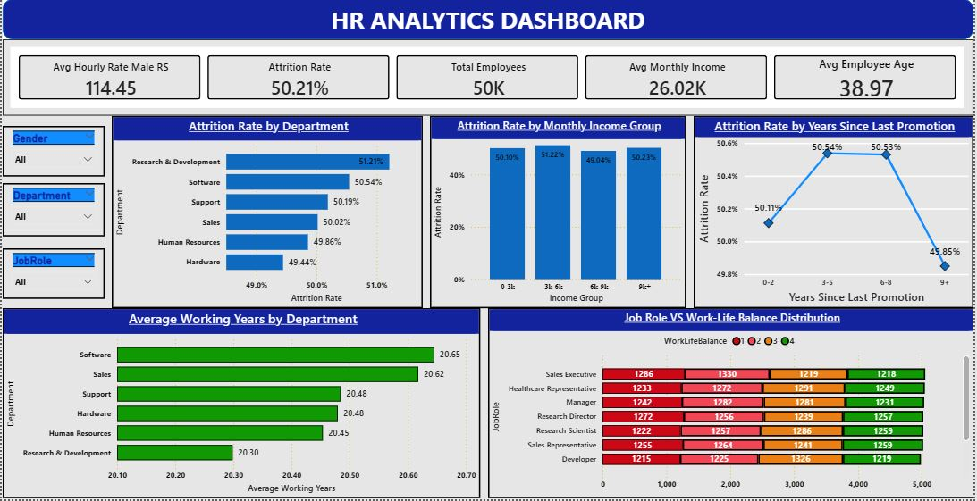
Power BI Dashboard

Slide 9
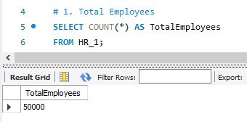
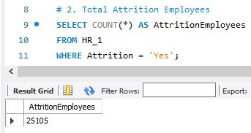
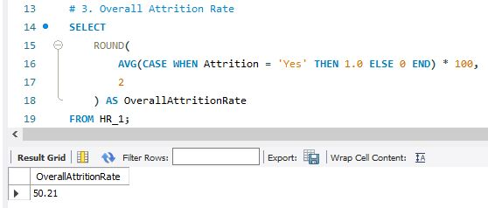
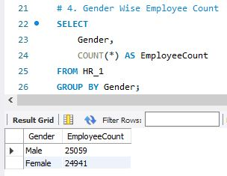
MySQL Queries

Slide 10
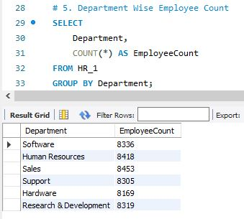
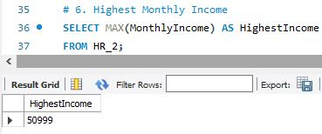
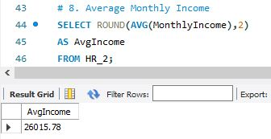
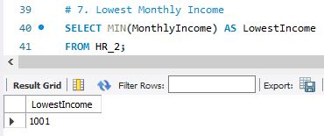

Slide 11
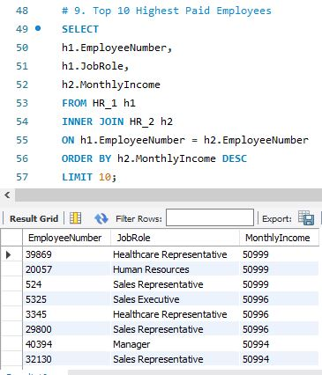
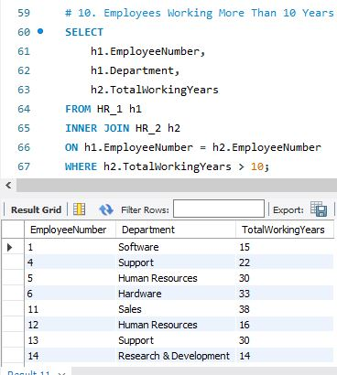
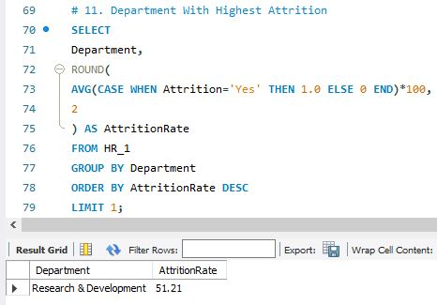

Slide 12
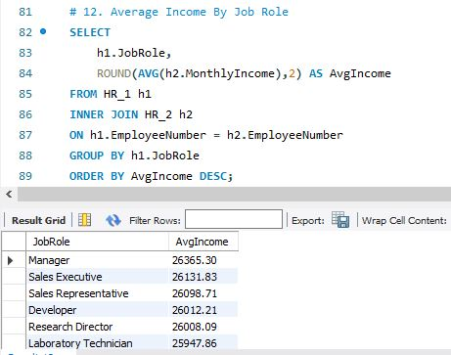
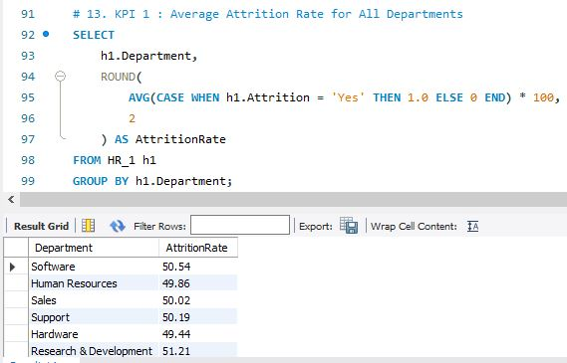
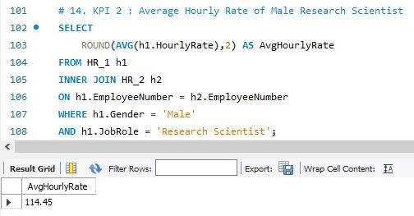

Slide 13
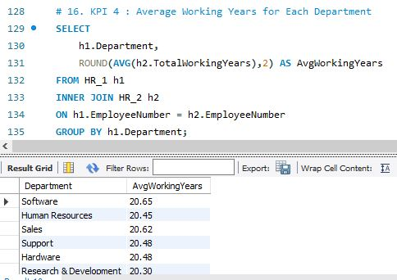
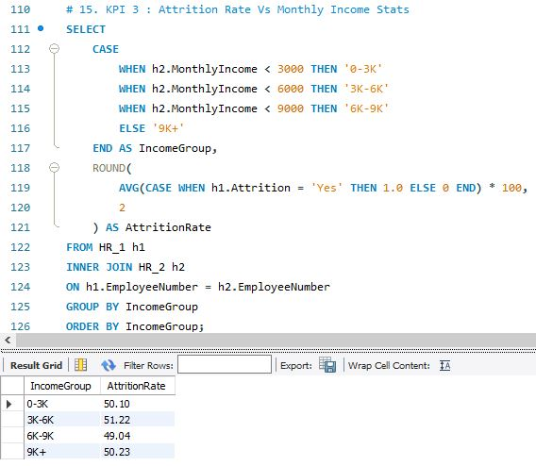
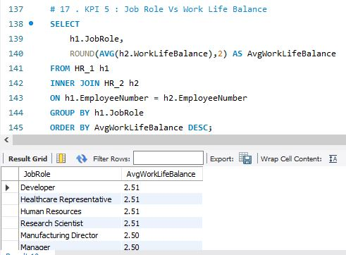

Slide 14
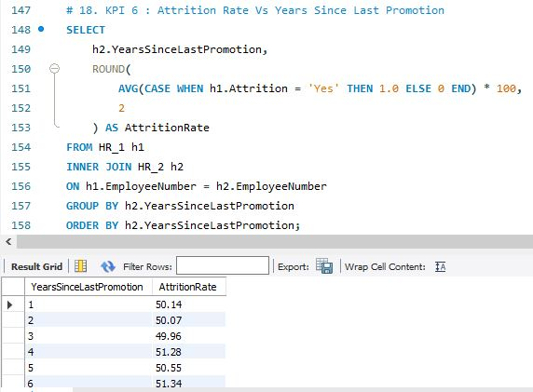
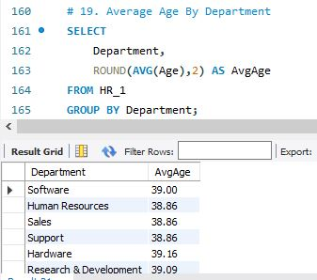

Slide 15

Challenges Faced & Solutions
Challenges Faced
Data was available in two separate Excel workbooks, so combining the data correctly was challenging.
Some columns needed proper relationships and joins using Employee_Number.
Large employee data made analysis and visualization slightly complex.
Attrition analysis across departments and income groups required proper grouping formulas.
Sorting income groups like 0–3k, 3k–6k, and 6k–9k correctly in charts was difficult.
Choosing the correct chart type for each KPI was challenging.
Maintaining clean dashboard design while showing multiple insights together was difficult.
Solutions Implemented
Used Inner Join/Relationship between HR_1 and HR_2 datasets using Employee_Number.
Created calculated fields such as Attrition Flag for accurate attrition calculation.
Used formulas to group Monthly Income into salary ranges for better analysis.
Built KPI cards to show important metrics clearly at the top of the dashboard.
Used bar charts to compare attrition across departments and income groups.
Used heatmap visualization to analyze Work-Life Balance by Job Role.
Applied filters for Gender, Department, and Job Role to make the dashboard interactive.
Organized the dashboard layout properly for better readability and presentation.

Slide 16
Conclusion
The HR Analytics dashboard successfully provides insights into employee attrition and workforce trends.
Research & Development department showed the highest attrition rate.
Salary, promotion history, and work-life balance have an impact on employee attrition.
The dashboard helps identify departments and employee groups needing HR attention.
Interactive visuals make data analysis faster and easier.
This project improves decision-making for employee retention and workforce management.
Overall, the dashboard converts raw HR data into meaningful business insights.

Slide 17
THANK YOU

